Slide 1
BaaS Overview
Hyeyoung Park
goblinok@gmail.com

Slide 2
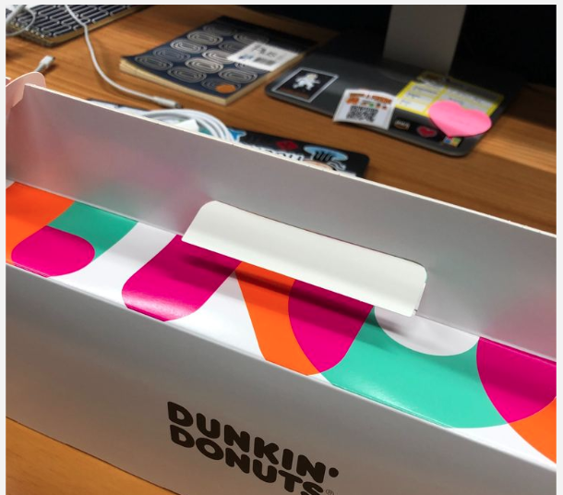
BaaS 분과 1차 모임 (1/21)
시간&장소 : GS타워 12층/18시 30분
Summary : BaaS 리서치 목록 논의 및 업무 분장
Azure – 강재욱, 박혜영
AWS – 여현승, 이정은
IBM – 도상집, 이재석
Luniverse – 정훈주, 홍범선
Kaleido – 오혁, 박천구

Slide 3
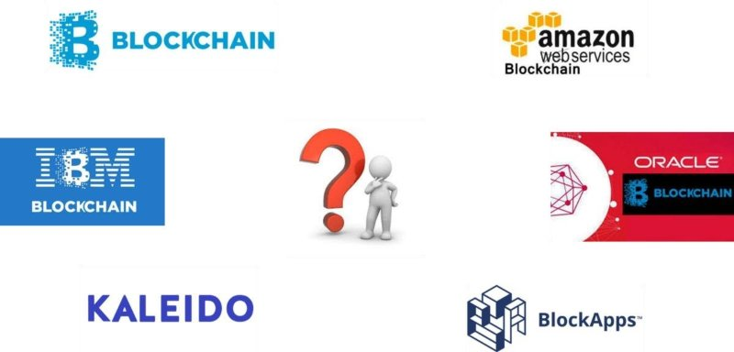
What is BaaS?

Slide 4
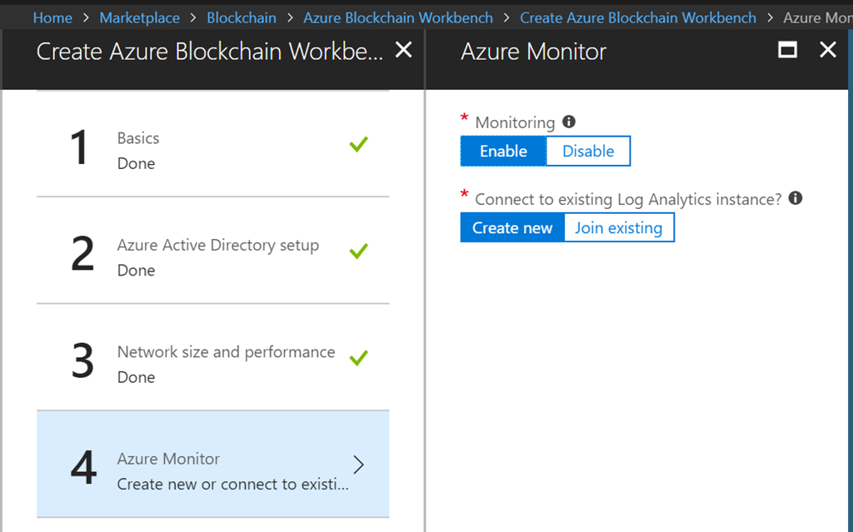
1. Azure Blockchain template
https://azure.microsoft.com/en-in/resources/templates/blockchain/
Azure Blockchain Workbench (IDE)
Azure Blockchain Development kit
Hyperledger Fabric and Ethereum (pow, poa), Quorum, Chain, Corda
Use Cases: Xbox, 3M, Insurwave, Wallmart
they have offered a super easy platform ‘Azure Blockchain Workbench’ to deploy blockchain and develop Smart Contact, plus they offer snapshot of blockchain data into SQL database to allow data query or BI analysis.
Azure Blockchain Development kit extends the capabilities of the Azure blockchain developer templates and Azure Blockchain Workbench, which incorporates Azure services for key management, off-chain identity and data, monitoring, and messaging APIs into a reference architecture that can be used to rapidly build blockchain-based applications.

Slide 5
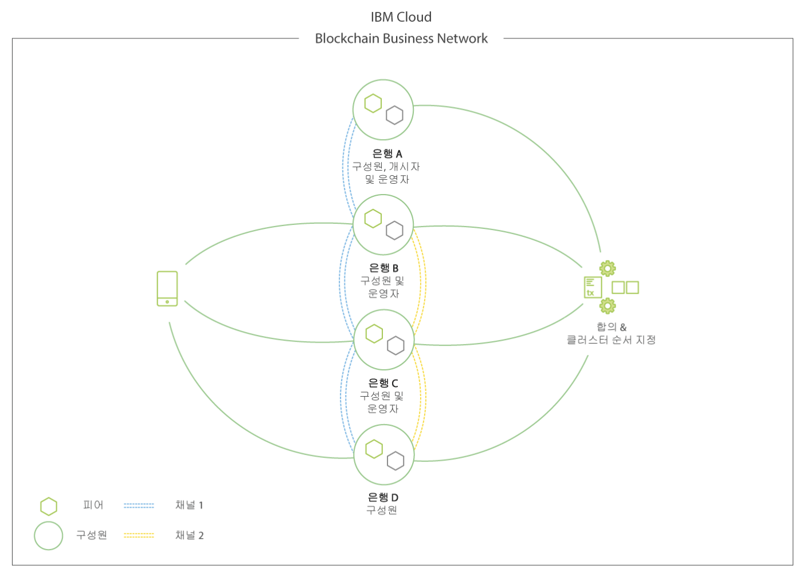
2. IBM Blockchain Platform
https://console.bluemix.net/docs/services/blockchain/index.html#ibm-blockchain-platform
https://ibm-blockchain.github.io/develop/installing/installing-index
Hyperledger Fabric
Hyperledger Composer

Slide 6
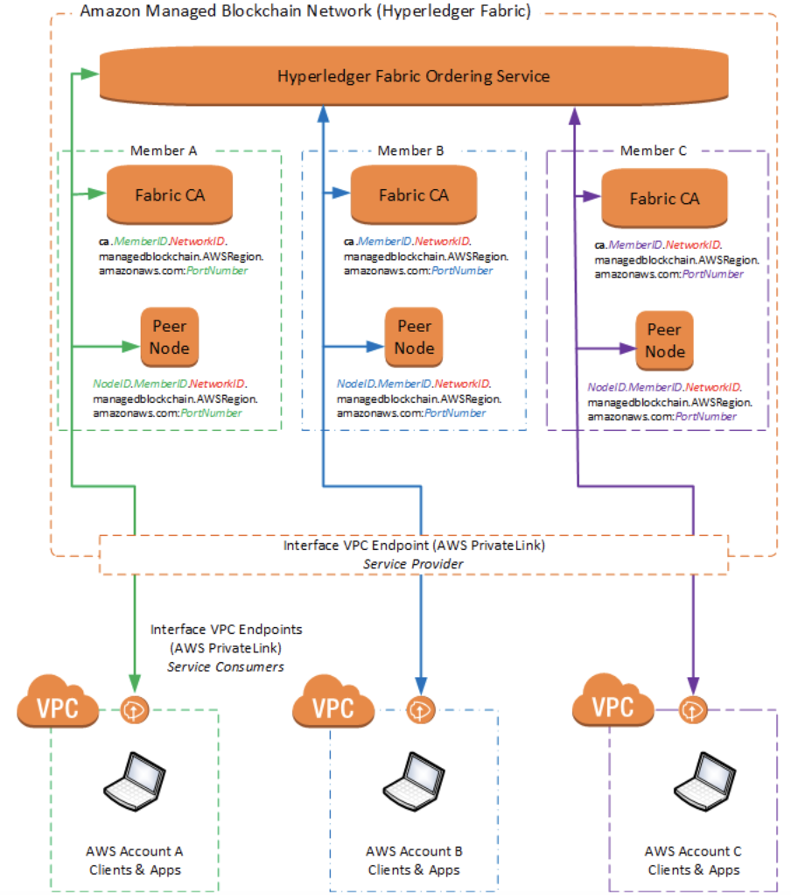
3. AWS Managed Blockchain
https://docs.aws.amazon.com/managed-blockchain/latest/managementguide/network-components.html
Preview
Hyperledger Fabric and Ethereum (TBD)
Use Cases: T mobile, Guidwire
https://aws.amazon.com/ko/managed-blockchain/
http://goodjoon.tistory.com/269?category=632199

Slide 7
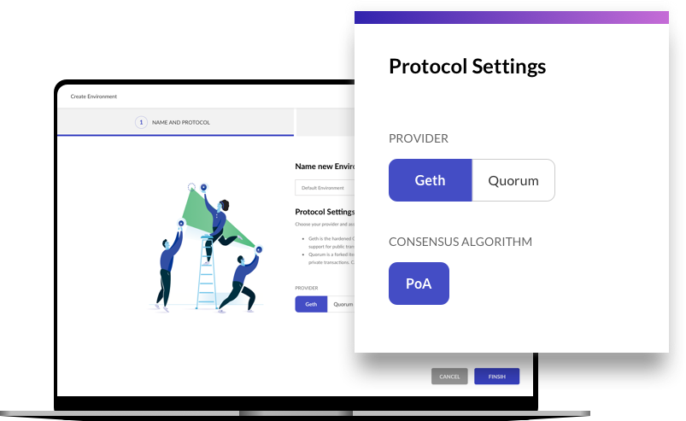
4. Kaleido Enterprise Blockchin SaaS
https://kaleido.io/
advanced SaaS platform with all the essential building blocks to build and optimize complete blockchain business solutions including 3rd party technology available via the Kaleido Marketplace. Scale elastically with hardened runtime, security, network isolation and dedicated storage. Integrate directly with other AWS services via account linking.

Slide 8
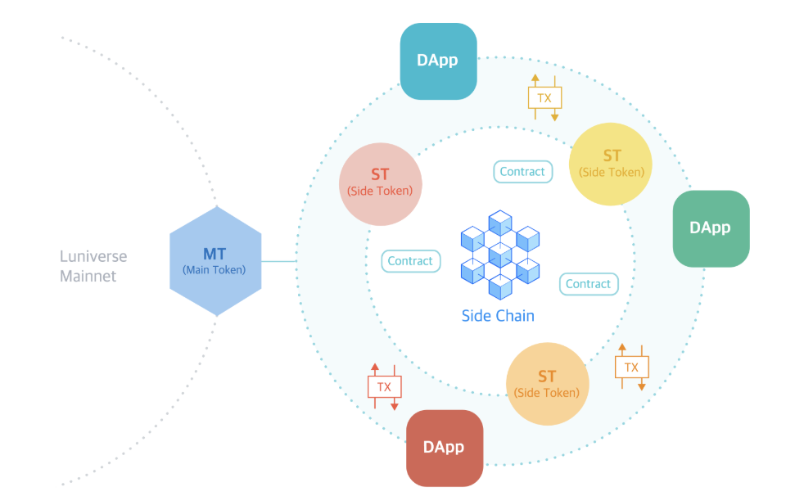
5. Luniverse Blockchain Service Platform
https://www.luniverse.io/

Slide 9
6. Cisco Blockchain Platform
https://developer.cisco.com/blockchain/
Cisco Blockchain Sandbox (IDE)
Cisco Blockchain Platform provides an end-to-end development environment on AWS and the tools needed to build enterprise-class blockchain solutions. This Quick Start provides a fast and easy way to deploy Cisco's Blockchain network.
This quick start deploys Cisco Blockchain Platform on the Amazon Web Services (AWS) Cloud in about an hour.

Slide 10
7. Oracle Blockchain Application Cloud
https://cloud.oracle.com/blockchain
Hyperledger Fabric

Slide 11
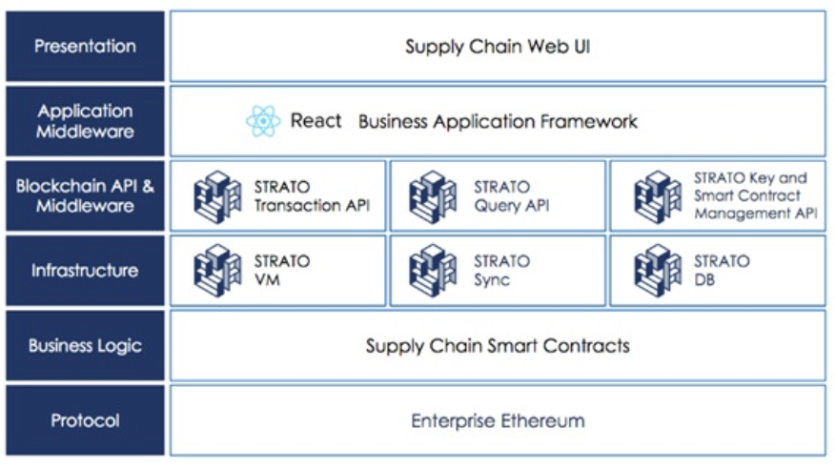
8. Blockapps
https://aws.amazon.com/blogs/apn/building-managing-and-deploying-blockchain-applications-with-blockapps/
Cisco Blockchain Sandbox (IDE)
BlockApps is a leading provider of Ethereum blockchain development solutions. Their private implementation, written in Haskell, provides a highly scalable Ethereum-compliant blockchain with an industry standard RESTful API and an easy-to-use web-based management dashboard.

Slide 12
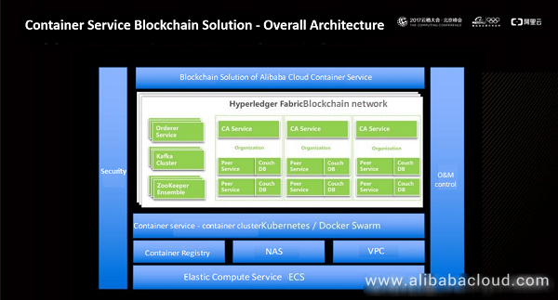
9. Alibaba Cloud BaaS
https://www.alibabacloud.com/ko/products/baas
https://www.alibabacloud.com/blog/alibaba-cloud-container-service-for-blockchain_593941

Slide 13
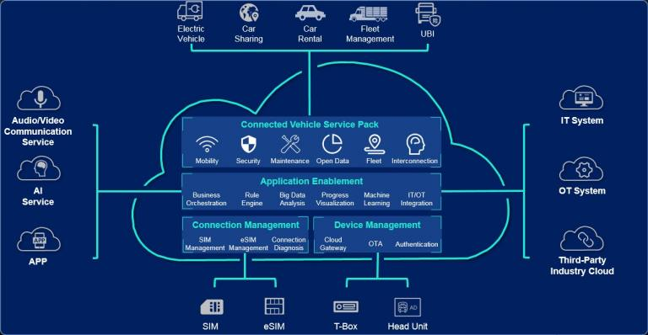
10. Huawei Cloud – Blockchain Sevice
https://intl.huaweicloud.com/product/bcs.html
https://www.slideshare.net/eraser/huawei-blockchain-whitepaper-toward-a-trusted-digital-world-april-2018

Slide 14
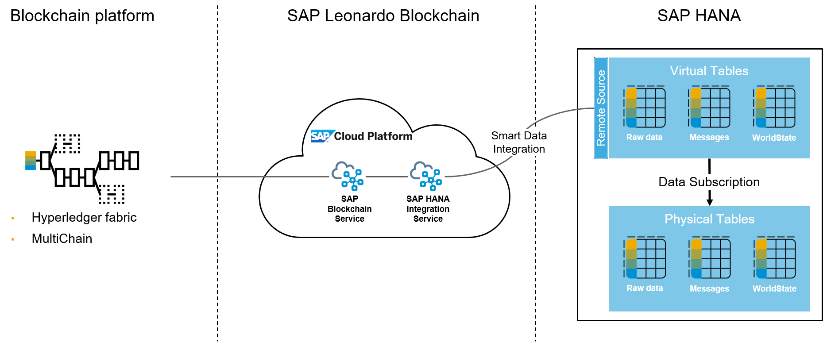
11. SAP Blockchain
https://www.sap.com/korea/products/leonardo/blockchain.html

Slide 15
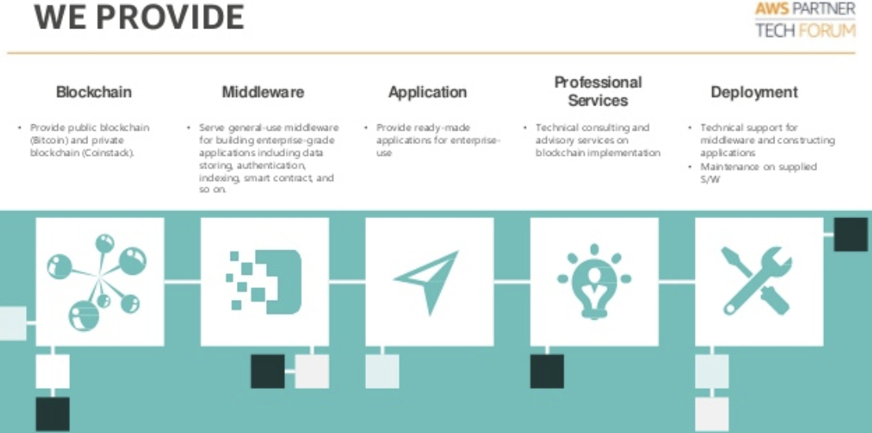
12. Blocko
https://www.blocko.io/platform.html

Slide 16
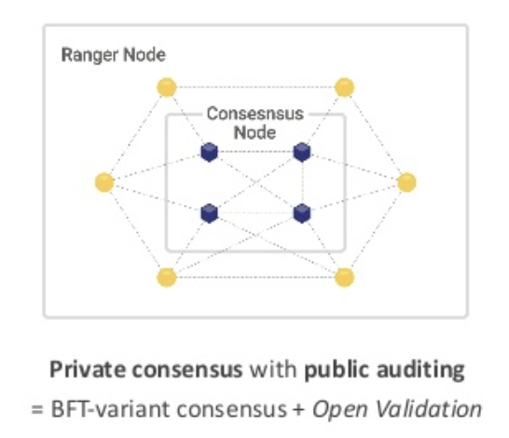
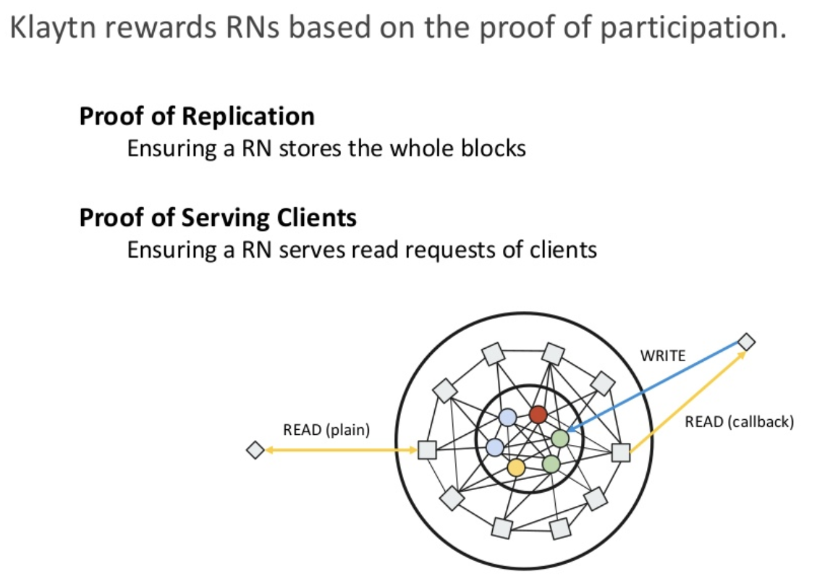
13. Klaytn
https://www.klaytn.com/
https://www.slideshare.net/ifkakao/klaytn-serviceoriented-enterprisegrade-public-blockchain-platform
GroundX

Slide 17
평가 Metrix
사용성
기능성
안전성
비용
성능
?

Slide 18
[참고] BaaS 평가 Metrix (TBD)
지원하는 Consensus Algorithm (예. Hyperledger, Ethereum etc)
속도 및 성능 (예. TPS)
IDE 제공 유무 (예. Workbench, Sendbox )
API, SDK 제공 여부
비용 구조
다른 서비스 Integration 가능 유무 (인증, 빅데이터 등)
추가 제공 서비스 (예. Contract 보안 점검)
Use Cases (Major Clients)

Slide 19
[참고] BaaS분과 산출물 (TBD)
산출물
플랫폼별 기능 비교
BMT
메뉴얼
Raw 설치대비 효과
BaaS 미래
Private BaaS와 Public BaaS

Slide 20
업무 분장
Azure – 강재욱, 박혜영
AWS – 여현승, 이정은
IBM – 도상집, 이재석
Luniverse – 정훈주, 홍범선
Kaleido – 오혁, 박천구

